Slide 1

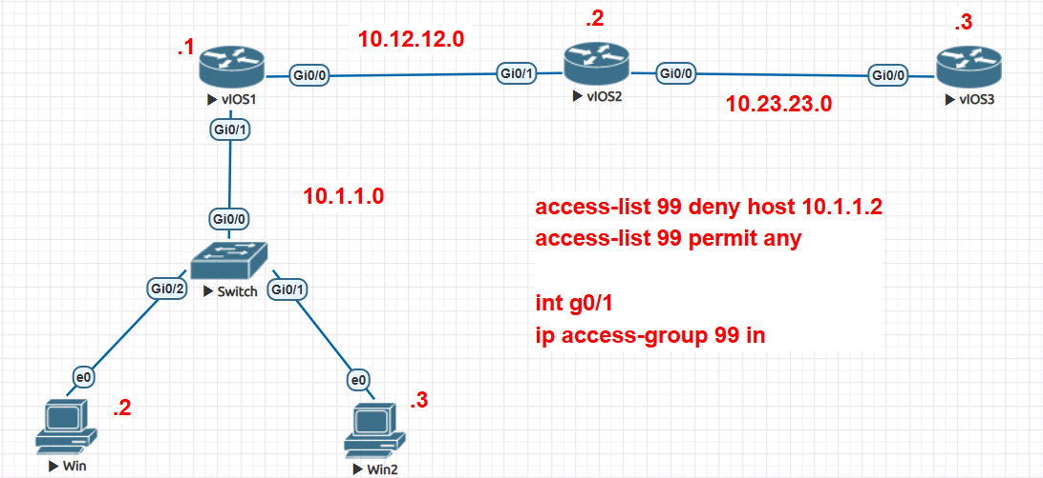
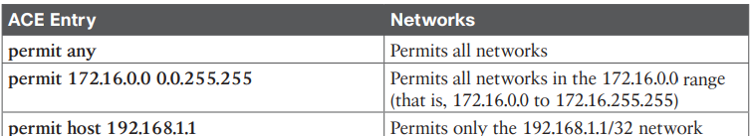
Router Security
1. Standard ACL (can’t specify dest, port, protocol) Restrict access from 10.1.1.2 to R3, ensuring other traffic remains unaffected. (Remember: always apply at the destination interface)
!! Create Standard ACL (1-99 || 1300-1999)
host -- access-list <acl-no> <deny / accept> host <ip> network -- access-list <acl-no> <deny / accept> <network-address> !! Other traffic will either be denied or allowed access-list <acl-no> <permit/deny> any
!! Apply ACL int <ethernet-type> <interface-no> ip access-group <acl-no> <in / out>
O(n)

Slide 2
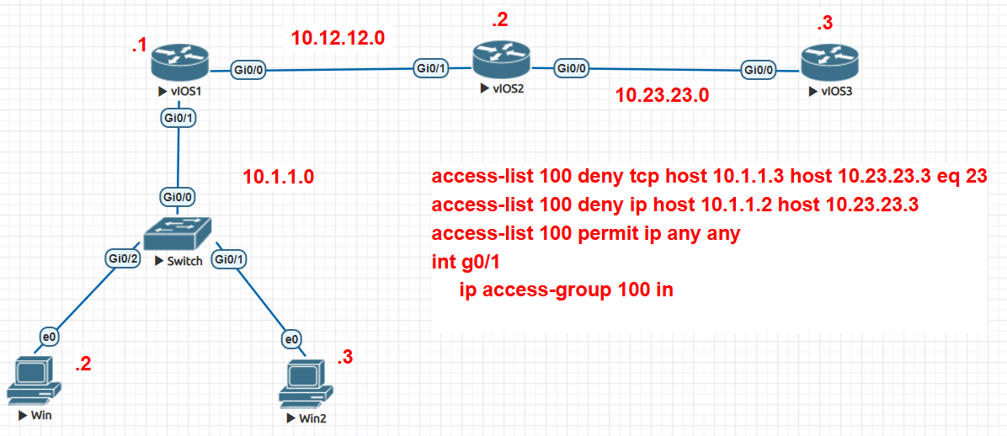
2. Extended ACL (can specify dest, port, protocol) It should be applied on the router closest to the device, in order to avoid unnecessary forwarding decisions on other routers. task: Restrict access from 10.1.1.2 to 10.23.23.3 Restrict only telnet access from 10.1.1.1 to 10.23.23.3
!! Create Extended ACL (100-199 || 1300-1999) access-list <acl-no> <protocol> <src-host> <address> <dst-host><address> eq <port-no> !! Other traffic will either be denied or allowed access-list <acl-no> <permit/deny> ip any any
!! Apply ACL int <ethernet-type> <interface-no> ip access-group <acl-no> <in / out>
O(1)

Slide 3
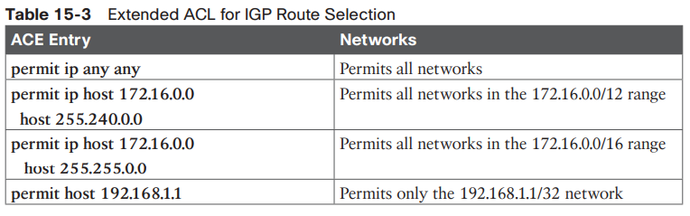
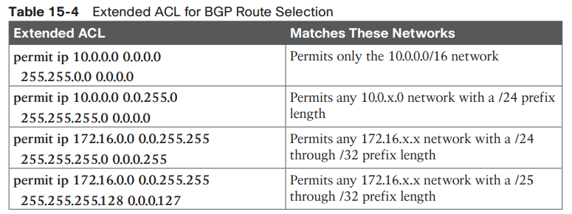

Slide 4
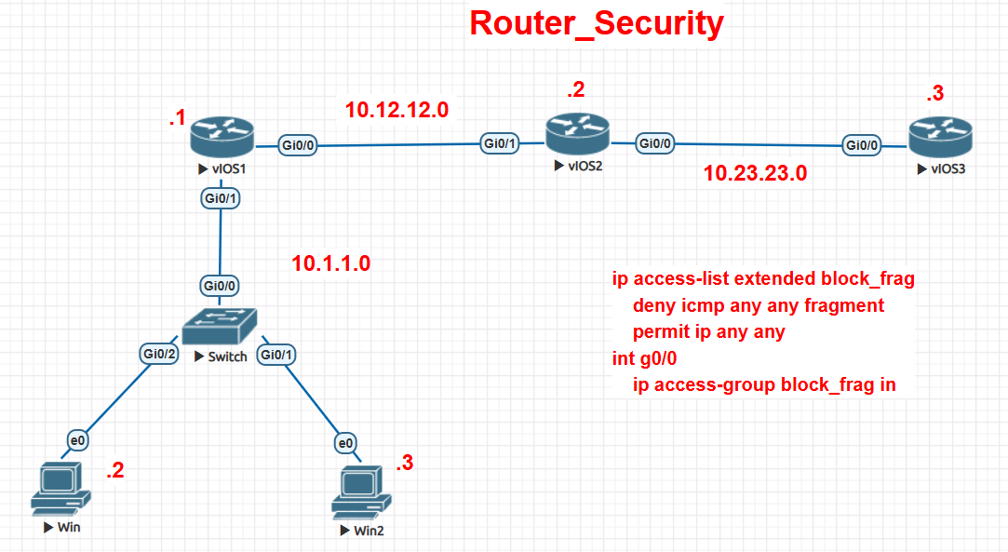
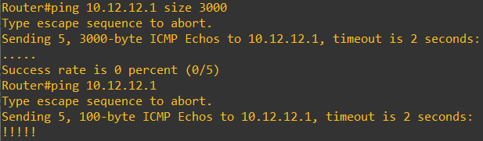
3. Infrastructure ACL An Infrastructure ACL (iACL) is a special type of Access Control List that is applied to protect the network devices themselves, not just the traffic passing through them. (test: deny ICMP fragment)
!! Create Extended ACL (100-199 || 1300-1999)
ip access-list extended <NAME / NO> deny <protocol>any any fragments permit ip any any (permit tcp host < external-bgp-peer> host < internal-bgp-peer> eq bgp)
!! Apply ACL int <ethernet-type> <interface-no> ip access-group <name / no> <in / out>

Slide 5
3. Prefix List
A prefix list is used to filter network prefixes (routes) based on:
• The network address (e.g., 10.0.0.0)
• The prefix length (e.g., /8, /24, /32)
ip prefix-list MY-LIST seq 5 permit 10.0.0.0/8 le 24
ip prefix-list MY-LIST seq 10 deny 192.168.0.0/16
ip prefix-list MY-LIST seq 15 permit 0.0.0.0/0 le 32

Slide 6
3. Route Map
Route maps are like “if–then” statements for routing. They let you:
• Filter routes (like ACLs do), and
• Modify route attributes (which ACLs cannot).
They are especially important in BGP, because you can define custom routing policies per neighbor.
Route Map Components
A route map has four parts:
1. Sequence Number
Determines the order in which each part of the route map is checked.
Example: sequence 10 is processed before sequence 20.
2. Matching Condition (if)
Defines which routes the statement applies to (like IP prefix, AS path, next-hop, etc.).
Example: match IP addresses in an ACL or prefix list.
3.Action (then)
What to do when a route matches.
Either permit (allow and possibly modify) or deny (block).
4. Optional Actions (modifications)
Additional actions, such as setting or changing attributes (metric, local preference, next-hop, etc.).

Slide 7
4. Authentication

